Slide 1
3D Horn
Shubham Jaiswal
Sunil Gayke
HIA-Pune

Slide 2
Agenda
Noise pollution
Introduction to 3-D Horn
Working Principle
Sequence of flow of communication
Failing Scenarios
Future expansion
Conclusion

Slide 3
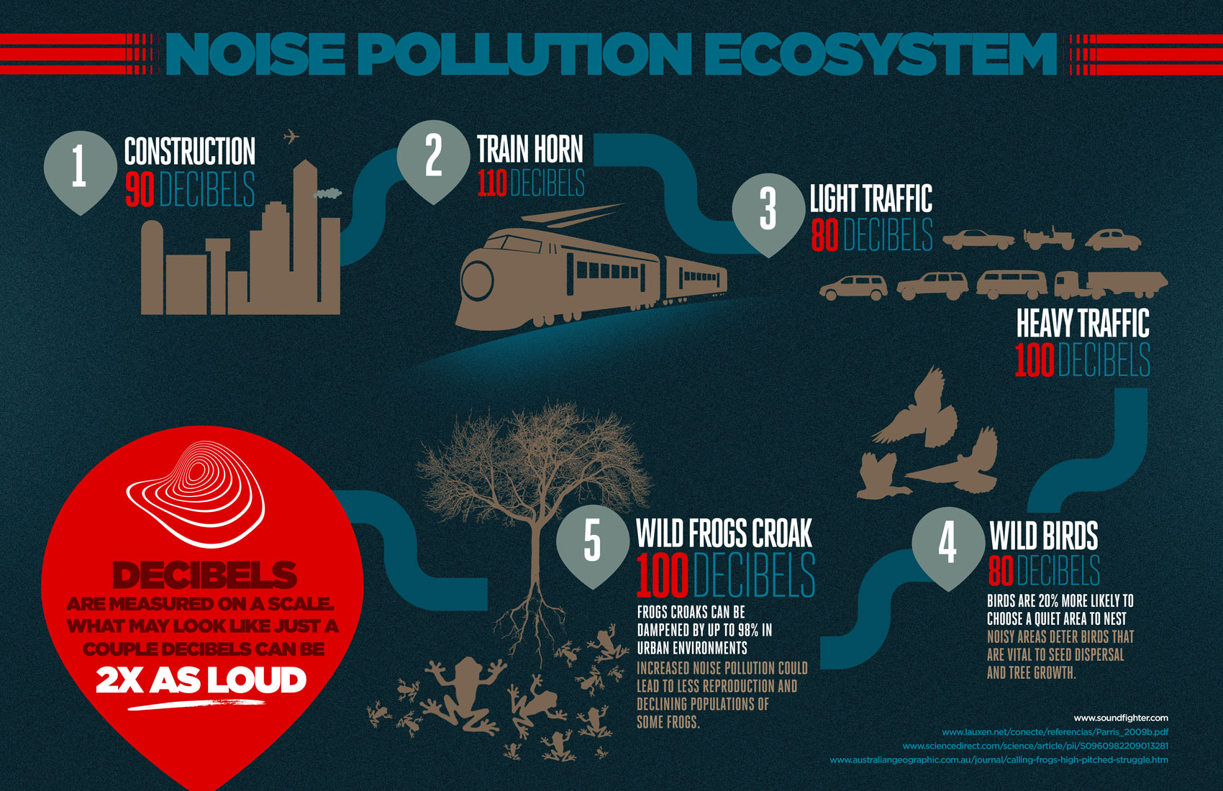

Slide 4
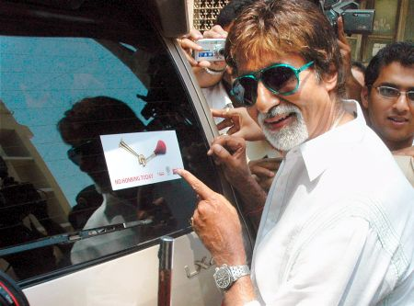
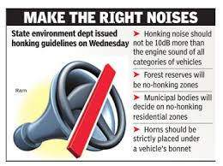



Initiatives taken to stop honking

Slide 5
What is 3-D HORN?
A technology which solves the purpose of honking without disturbing the environment.
Horns will be heard by the drivers only and not by pedestrians or surrounding environment.
Driver will be able to locate the position of the outside car because of the 3-d effect.
Array of relatively small speakers will be placed on the roof top.
Components used: GPS, XIG-BEE T&R, Array of small speakers.
3-D Horn gets activated as soon as ignition is detected.

Slide 6
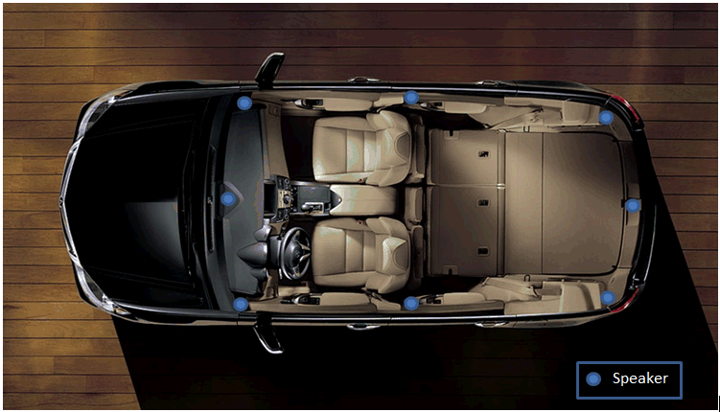
Speakers Position

Slide 7
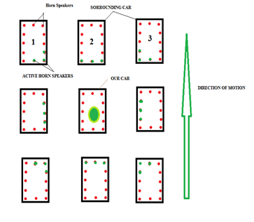
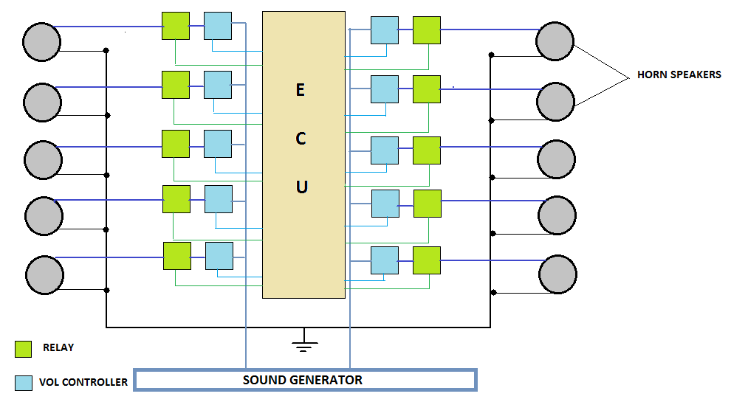
WORKING PRINCIPLE
Overview
Block Diagram

Slide 8
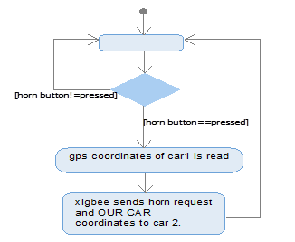
SEQUENCE OF FLOW OF COMMUNICATION
Transmitter
Receiver

Slide 9
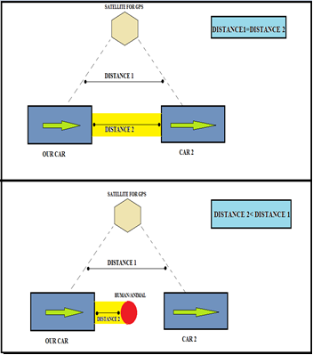
HUMAN DETECTION
Human detection is necessary in real time scenarios.
Any type of obstacles can come in front of the car which may be a human or animal or any other vehicle.
In these cases, 3-D horn will be of no use. Instead we need to blow an external horn to alert the obstacle.
Extra component required: Radar

Slide 10
Transmitter
Receiver

Slide 11
In case of Failure:
There can be various sources of failure of the functioning of 3-D horn such as:
Malfunctioning in GPS working due to unavailability of network.
Malfunctioning in XIGBEE working.
Etc
In all the above cases the external horn will be honked.

Slide 12
CONCLUSION
Honking is not a need, it has become a habit. But till the time this habit is improved by the future generation, we need to do something about the noise pollution caused by honking.
The 3-D HORN provides a solution which makes both the environment and the driver happy by solving their respective purpose.

Slide 13


